Slide 1

JGW Group
Mail Handling
Safety
in the age of COVID-19
Mail Handlers Safety and Security Training Series

Slide 2


Introduction Keith James – Training Director
JGW’s nationally recognized, best practice-based, mail center safety and security training program provides administrative, security and first responder personnel tasked with handling incoming mail or packages and responding to mail born threats with the knowledge and understanding needed to rapidly identify and safely respond to mail borne threats.

Slide 3
Mail Handling Safety in the Age of COVID-19
Agenda
Introduction
Understanding COVID-19
How does COVID-19 Impact Mail and Delivery Operations?
How Does the Virus Impact the Mail Center?
What is the Threat to Mail Center Personnel?
How Do We Respond?
Open Questions

Slide 4
Understanding COVID-19
Why is this different than past events impacting mail services?
  Rapid spread
  Inability to rapidly identify threat
  Continuous coverage
How is it transmitted?
  Direct contact with others
  Indirect contact with virus contained in droplets or left on surfaces
Can it be transmitted by mail or package delivery?
  Undetermined – while possible, this is highly unlikely

Slide 5
How Does COVID-19 Impact Mail and Delivery
Operations?
USPS
  Following CDC guidelines
  Service disruptions
  Protecting mail service personnel
  Overseas shipments
Commercial Carriers
  Continued service
  Guarantee suspension
Private Carriers
  Wild card

Slide 6
How Does the Virus Impact the Mail Center?
Personnel?
  Social norming – not as easy as it sounds
  Mandatory and self-imposed quarantine
  Shifting paradigms in the work center
    Change in staffing
    Change in task
Operations?
  Modifying protocols – changes should be in writing, not just verbal
  How does “work from home” impact mail operations?
  Getting corporate buy in

Slide 7
What is the Threat to Mail Center Personnel?
Who is at risk?
  Older personnel
  Individuals with pre-existing health conditions
  People living in densely populated areas
  Individuals dependent on mass transit
How do we reduce the potential for exposure?
  Reduced staffing
  Social distancing
  Proper use of PPE
  Minimize contact with others during receiving and delivery operations

Slide 8
How Do We Respond
Can we make social distancing work in mail operations?
  Yes - but this may require some creative thinking on your part
  Delineate specific work and waiting areas – mark with tape and signs
  Modify protocols to enhance social distancing – limit/rotate personnel at screening and sorting stations
  Eliminate/modify signature requirements
  Put all changes in writing!

Slide 9
How Do We Respond
Does personal protective equipment – PPE – help?
  Other than social distancing, PPE is the most effective way to prevent exposure
  Understanding capabilities and limitations of the equipment is paramount
  Train, practice, observe
  Minimum PPE – nitrile or latex gloves, respirator, eye protection
    Gloves
    Respirator / Mask
    Eye Protection

Slide 10
How Do We Respond
What steps can I take to protect my team while continuing to provide service?
  Stay informed
  Validate information
  Update and reassure your team daily
How do we guard against rumors and misinformation?

Slide 11

Questions

Slide 12
References
Centers for Disease Control and Prevention - www.cdc.gov
CDC – FEMA - www.coronavirus.gov
USA.Gov – www.USA.gov/Coronavirus
State Resources

Slide 13
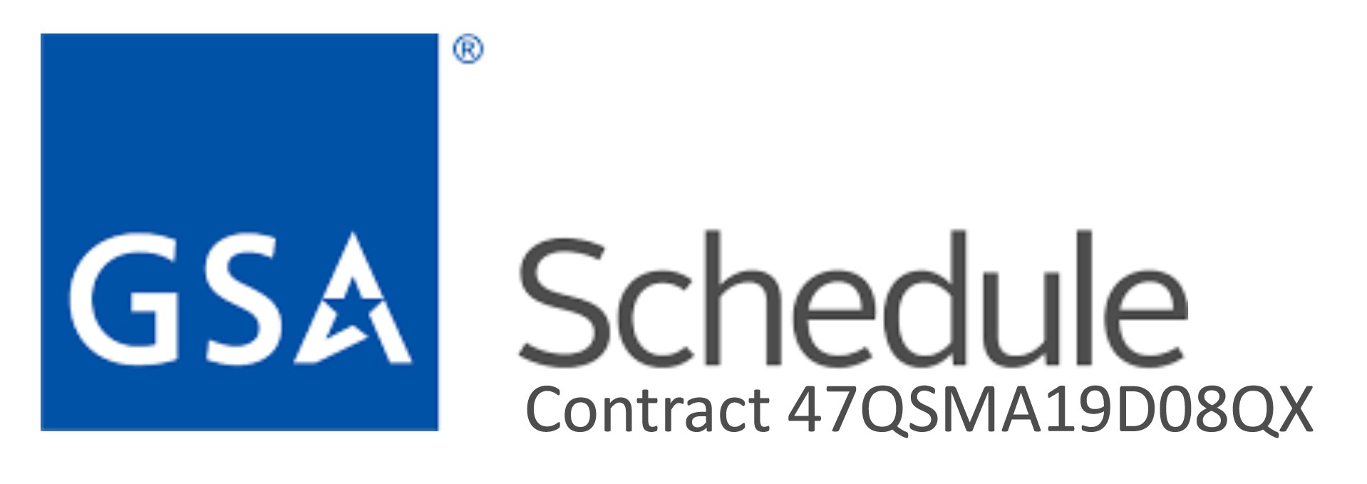
Introduction Keith James – Training Director
Contact Information:
M. K. James, Training Director JGW Group
1801 Robert Fulton Drive Suite 400
Reston, VA 20191
Tel: 703 547-6270
training@jgwgroup.com www.jgwgroup.com
Established in 1980, JGW Group specializes in business support; including Marketing & Sales, Business Development, Strategic Development, Contractual Planning, Proposal Preparation, New Equipment Fielding and Training, and Mail Center Safety and Security Process Development and Training.

